Slide 1
XML ENCRYPTION
Pranay Manek & Mansi Thakkar
Guide: Prof. Pradeep Surasura
K. L. E. Institute of Technology, Hubli.

Slide 2
Overview of xml
XML (Extensible Markup Language)
Standard for creating markup languages describes the structure of data.
Strong features of XML:
Intelligence, Adaption, Maintenance, Linking, Simplicity, Portability.
cont.……

Slide 3
Overview of xml
cont.……
Features of XML
Directly usable on internet
Supports wide variety of application
Easy for writing programs
Human legible and understandable.
Applications
Exchanging data
B2B
Sharing data
Storing data.

Slide 4
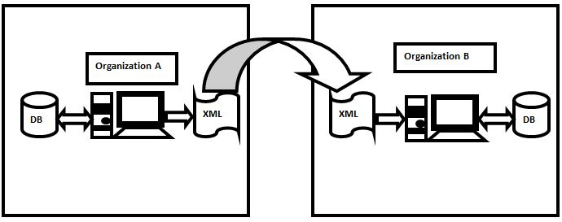
Working of XML
Fig. 1 Working of XML

Slide 5
Encryption overview
Encryption: Method of coding the original data with CIPHER TEXT and securing it is called encryption.
Keys
Private and public key
Two type of encryption
Symmetric
Asymmetric.

Slide 6
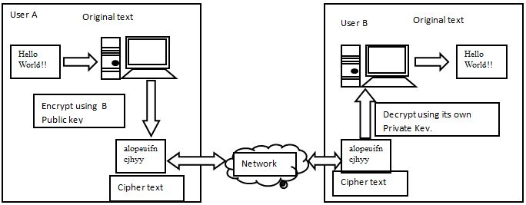
Example for Encryption
Fig. 2 Examples for encryption

Slide 7
XML Encryption Overview
XML Encryption: Process of encrypting elements from an XML document by replacing original XML content.
Three approaches
Symmetric encryption
Combination of Asymmetric and Symmetric encryption
Using X.509 Certificate

Slide 8
Syntax and Processing
<EncryptedData Id? Type? MimeType? Encoding?> <EncryptionMethod/>?
<ds:KeyInfo>
<EncryptedKey>?
<AgreementMethod>?
<ds:KeyName>?
<ds:RetrievalMethod>?
<ds:*>?
</ds:KeyInfo>?
<CipherData>
<CipherValue>?
<CipherReference URI?>?
</CipherData>
<EncryptionProperties>? </EncryptedData>

Slide 9
Example
Original XML Document
<?xml version='1.0'?>
<PaymentInfo xmlns='http://example.org/paymentv2'>
<Name>John Smith</Name>
<CreditCard Limit='5,000‘ Currency='USD'>
<Number>4019244502775567</Number>
<Issuer>Example Bank</Issuer>
<Expiration>04/02</Expiration>
</CreditCard>
</PaymentInfo>

Slide 10
EXAMPLE cont.……
Encrypting one of the element in the document will give the output.
<?xml version='1.0'?>
<PaymentInfo xmlns='http://example.org/paymentv2'>
<Name>John Smith</Name>
<EncryptedData Type='http://www.w3.org/2001/04/xmlenc#Element' xmlns='http://www.w3.org/2001/04/xmlenc#'>
<CipherData>
<CipherValue>A23B45C56</CipherValue></CipherData>
</EncryptedData>
</PaymentInfo>
Encrypting one of the element content in the document will give the output.
<?xml version='1.0'?>
<PaymentInfo xmlns='http://example.org/paymentv2'><Name>John Smith</Name>
<CreditCard Limit='5,000' Currency='USD'>
<EncryptedData xmlns='http://www.w3.org/2001/04/xmlenc#' Type='http://www.w3.org/2001/04/xmlenc#Content'>
<CipherData>
<CipherValue>A23B45C56</CipherValue>
</CipherData>
</EncryptedData>
</CreditCard>
</PaymentInfo>

Slide 11
Syntax for Specifying Key Information in The Encrypted XML File
<EncryptedData xmlns='http://www.w3.org/2001/04/xmlenc#'
Type='http://www.w3.org/2001/04/xmlenc#Element'/>
<EncryptionMethod Algorithm='http://www.w3.org/2001/04/xmlenc#tripledes-cbc'/>
<ds:KeyInfo xmlns:ds='http://www.w3.org/2000/09/xmldsig#>
<ds:KeyName>John Smith</ds:KeyName> </ds:KeyInfo>
<CipherData><CipherValue>DEADBEEF</CipherValue></CipherData> </EncryptedData>

Slide 12
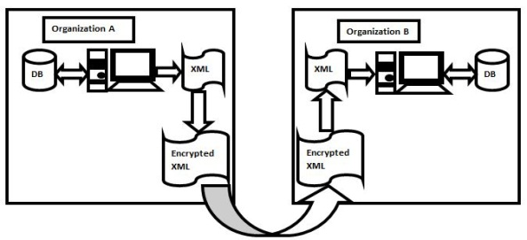
Encryption Decryption Process
Fig. 3 Encryption and decryption process

Slide 13
XML Encryption on Different Platforms
XML Encryption on Microsoft Platform.
XML Encryption on Java Platforms

Slide 14
Conclusion
XML is flexible and efficient.
It can be used on any platform and operating system.

Slide 15
THANK YOU

